Slide 1


SYP Elections 2026
MY CANDIDATE PRESENTATION - TEST
SCOTTISH YOUTH PARLIAMENT

Slide 2

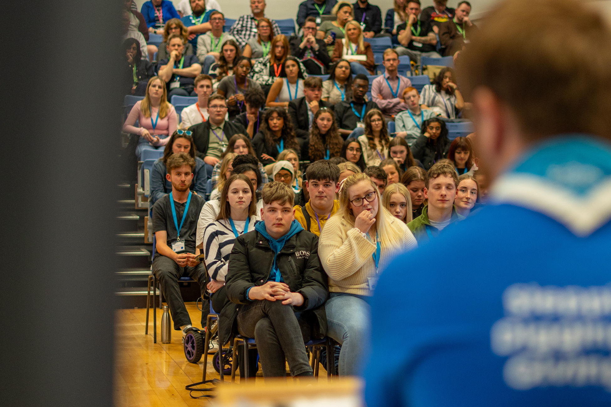
Who am I?
  I am a candidate in the SYP Elections.
  I want to be an MSYP.
  I will consult young people.
  My hobbies are fun.
  I go to school.

Slide 3
Why you should vote for me
  I will represent you
  I will listen to your views
  I will ask what you think
  I will let you know what I’m up to

